Slide 1
SolarChain
Adrian Diepeveen
221025168

Slide 2
Table of contents
1
2
3
4
5
Problem Staement
Solution
Logic and Complexity
Process Screenshots
SolarChain Application Demonstration

Slide 3
1
Problem Statement

Slide 4
Problem Statement
Increases costs and inefficiences
Hinders investment
Current challenges experienced
Reliance centralised systems
Fraudulent reporting

Slide 5
2
Solution

Slide 6
Solution
Non-repudiation
Enhance transparency
Blockchain ADT
Queue ADT
More accurate monitoring

Slide 7
3
Logic and Complexity

Slide 8
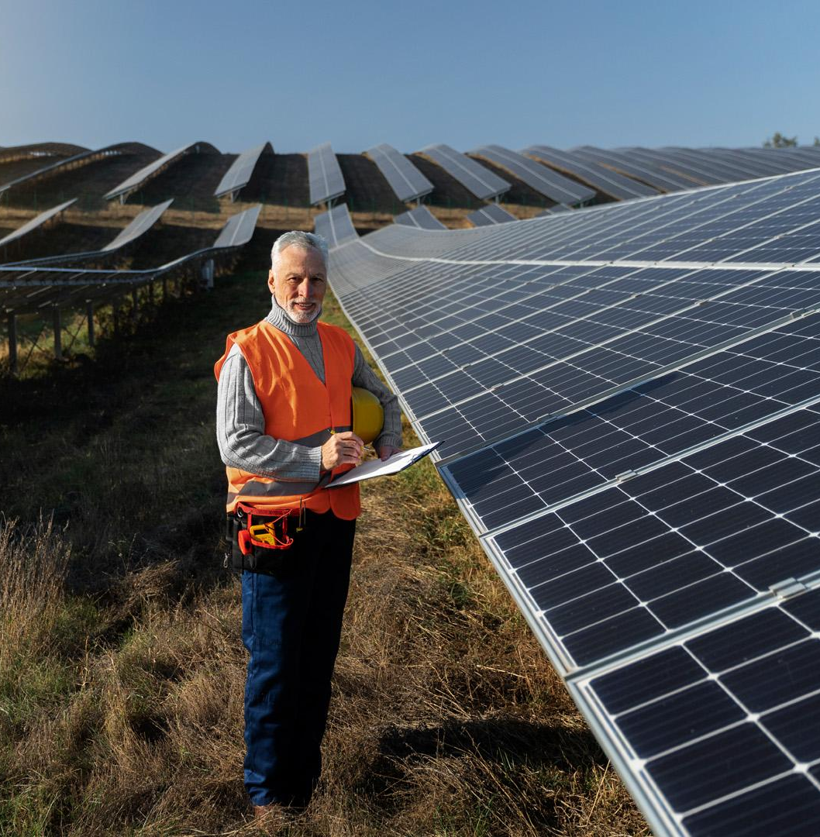
Blockchain ADT
Creation.
Validation.
Management.
Transactions are encapsulated in blocks.
Blocks are validated and then vetted to blockchain.

Slide 9
SolarEnergyData Transactions
int | solarEnergyID
String | transactionType
double | quantitySolarEnergyTraded
double | priceKwH
double | totalPriceTraded
String | date

Slide 10
Certificate Transactions
int | certificateID
String | transactionType
String | renewableEnergyType
double | priceMwH
double | carbonEmissionsOffset
double | totalPriceTraded
String | certificateFile
String | date

Slide 11
4
SolarChain Application Demonstration

Slide 12
5
Process Screenshots

Slide 13
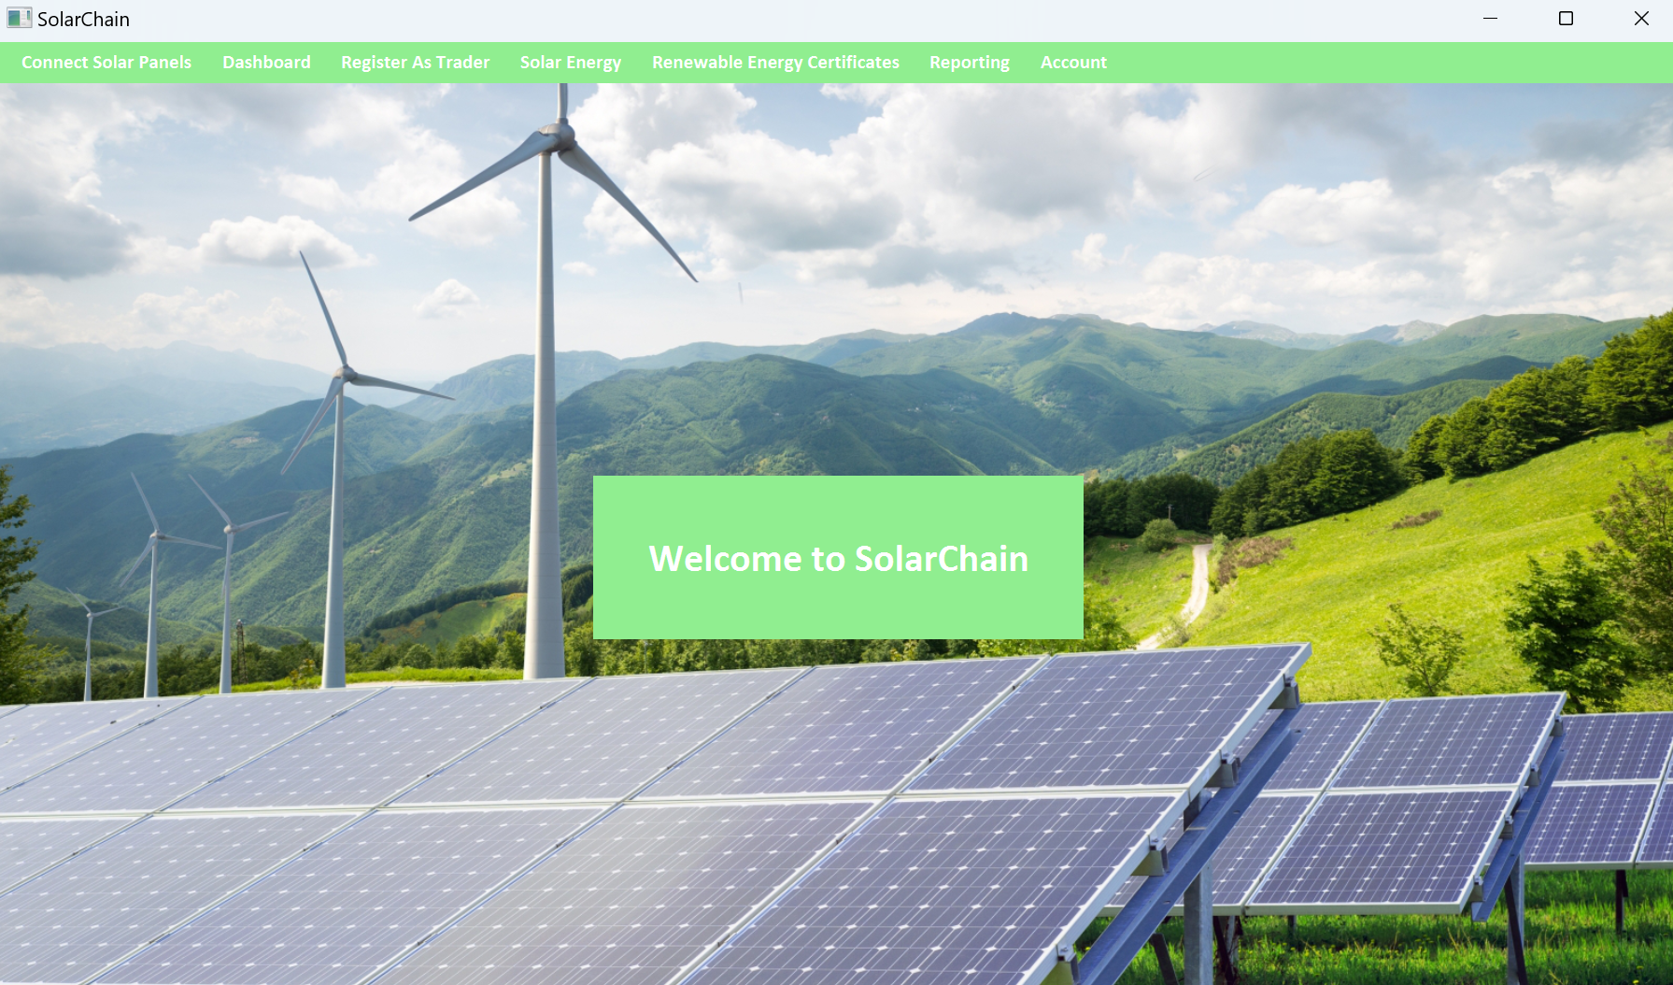

Slide 14
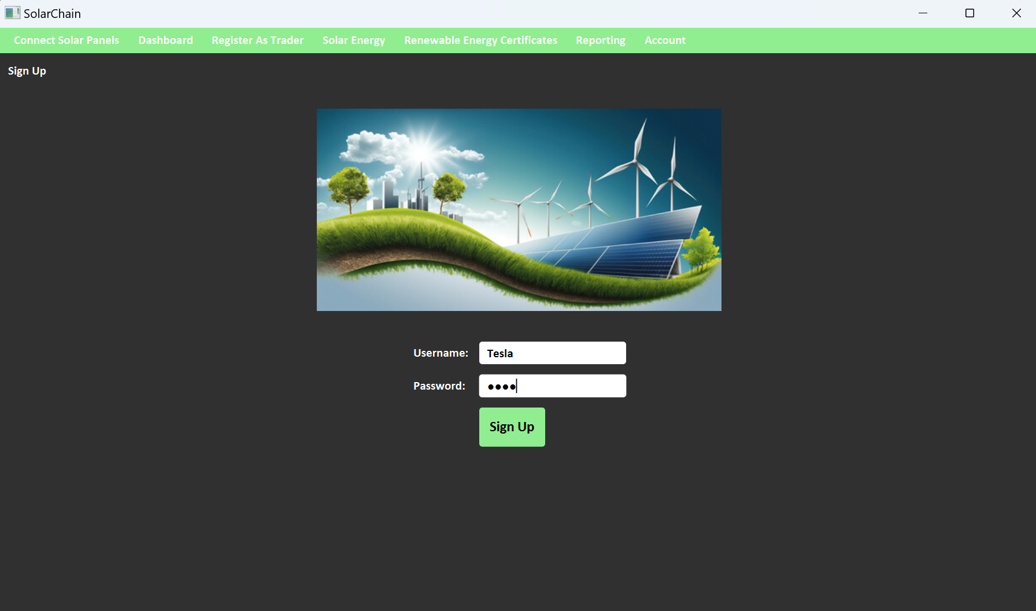

Slide 15
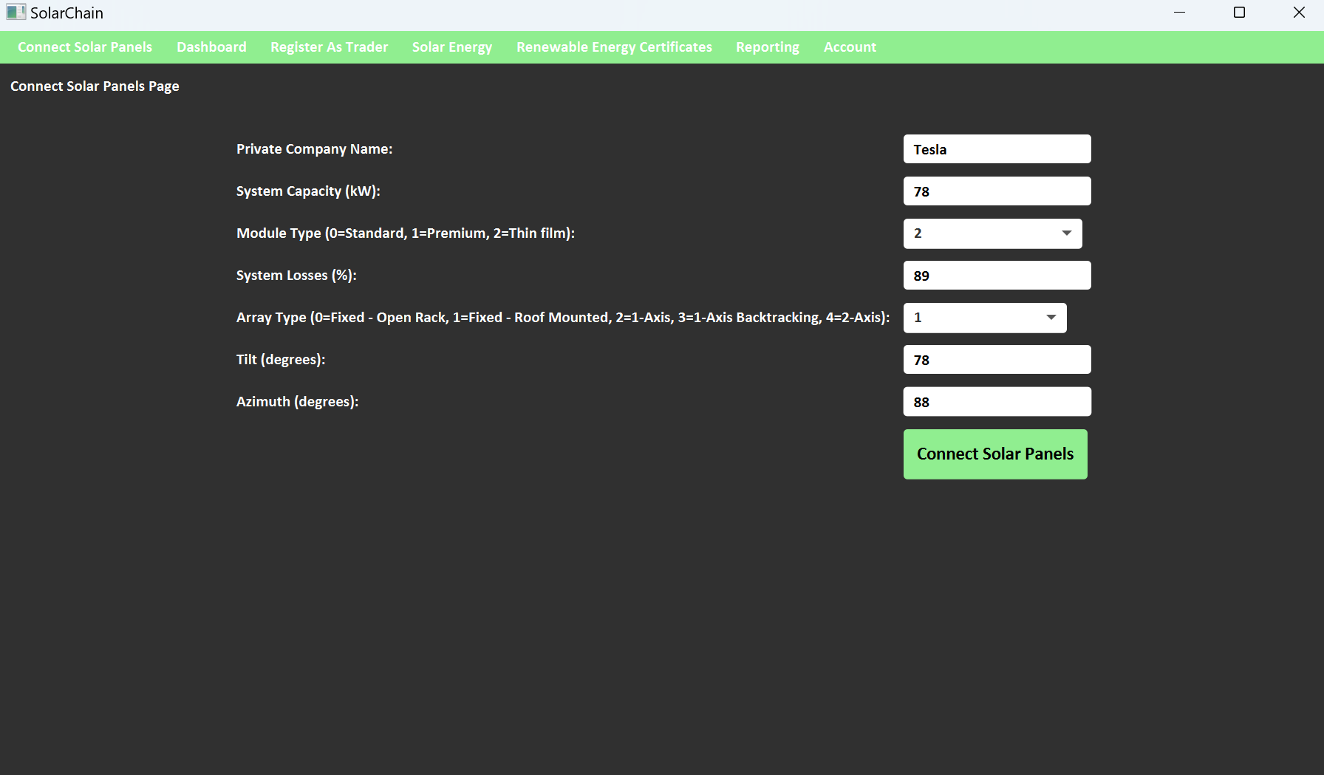

Slide 16
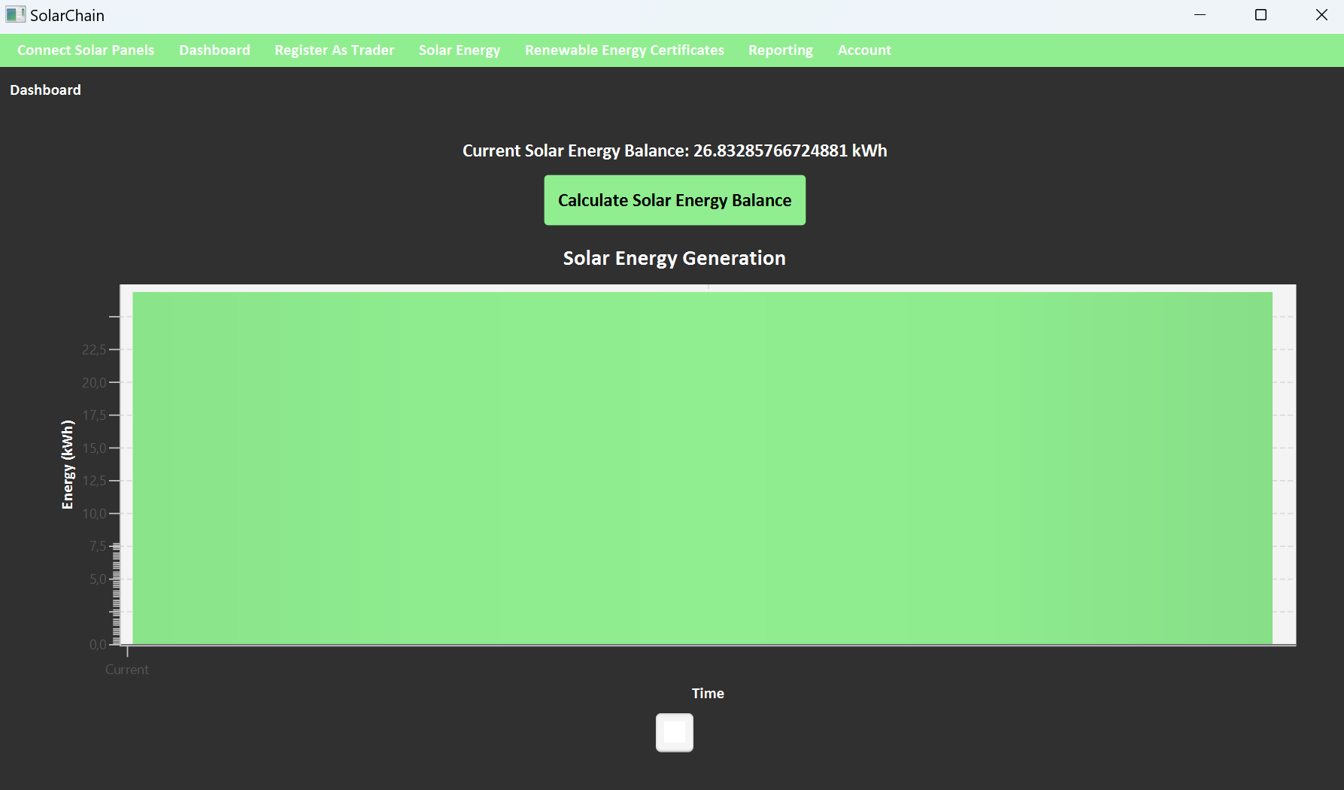

Slide 17
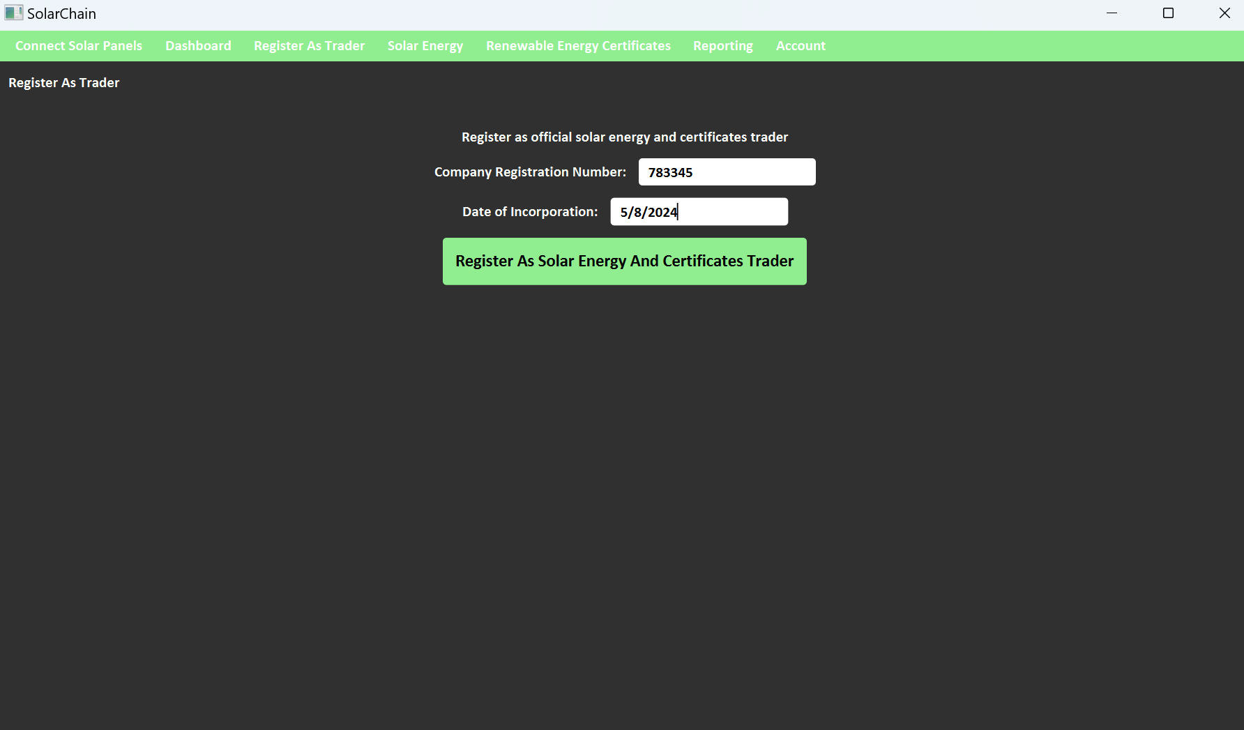

Slide 18
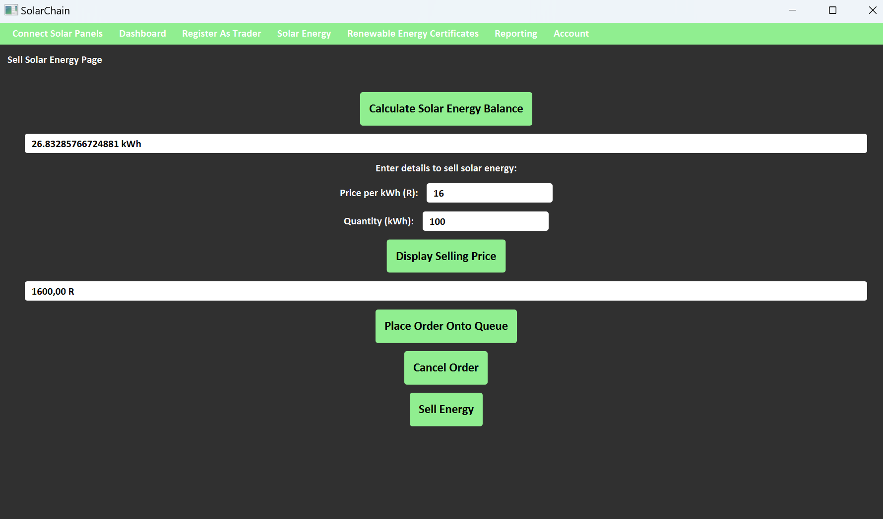

Slide 19
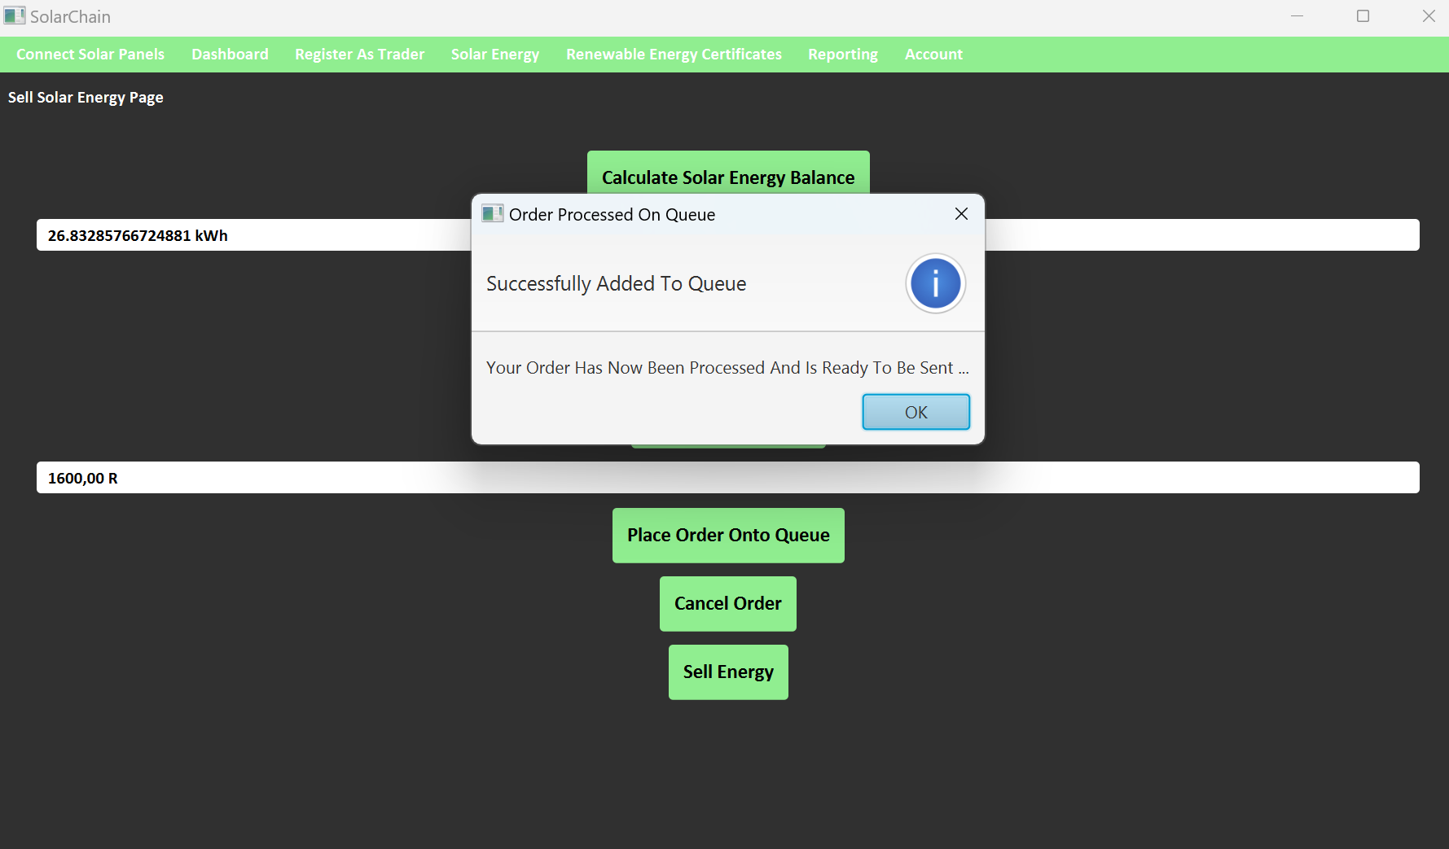

Slide 20
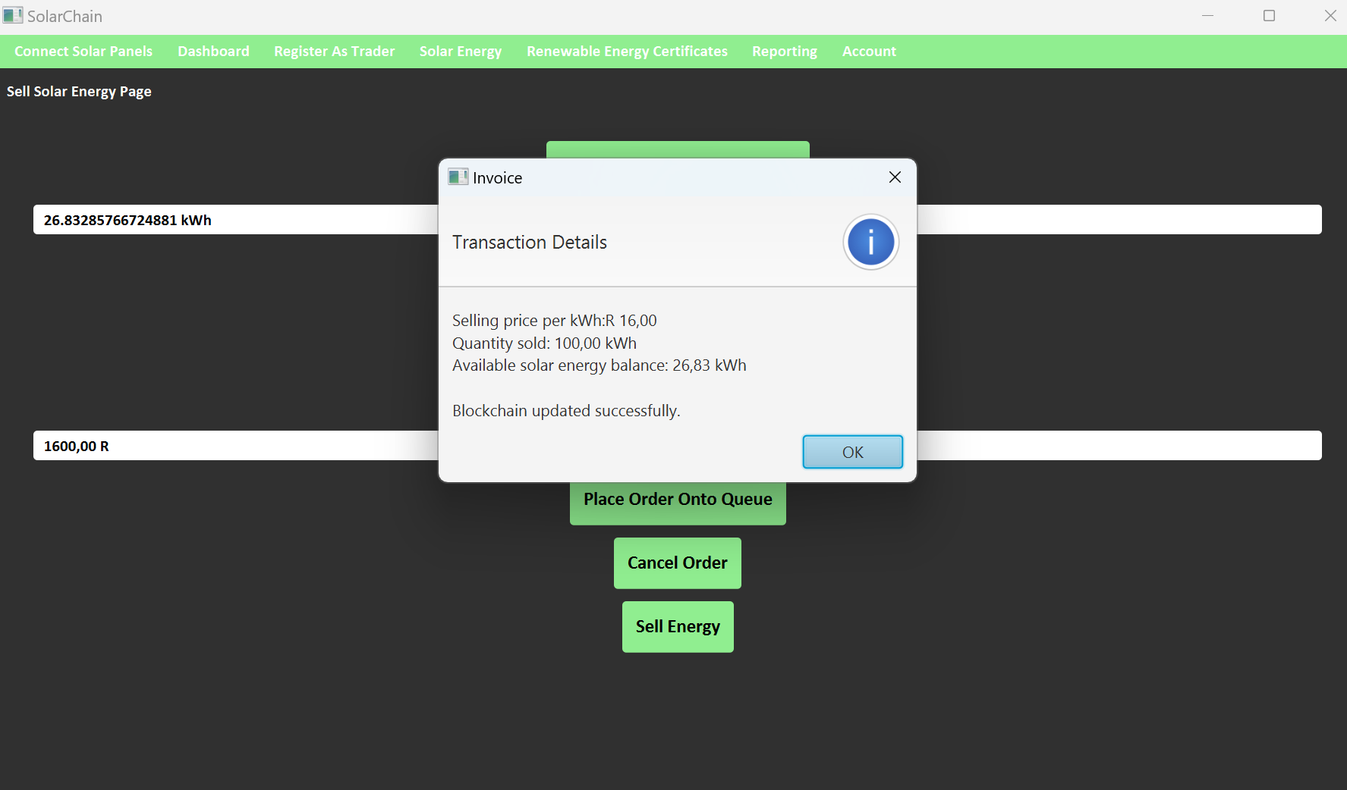

Slide 21
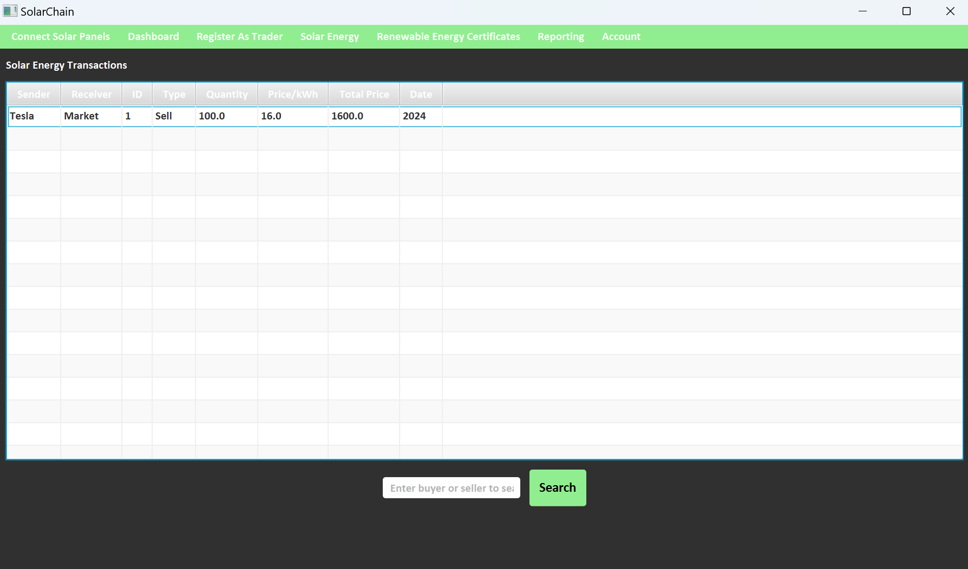

Slide 22
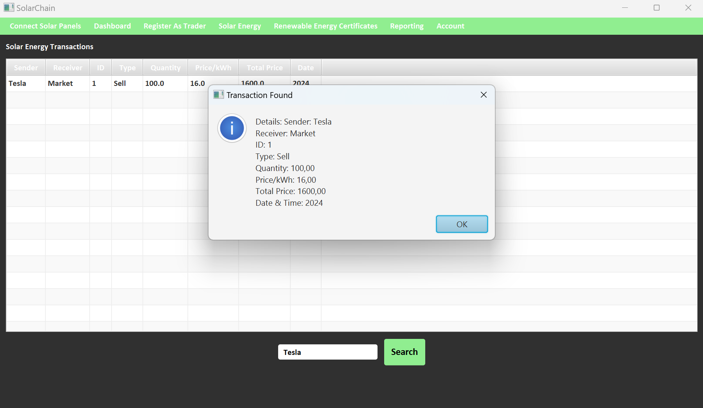

Slide 23
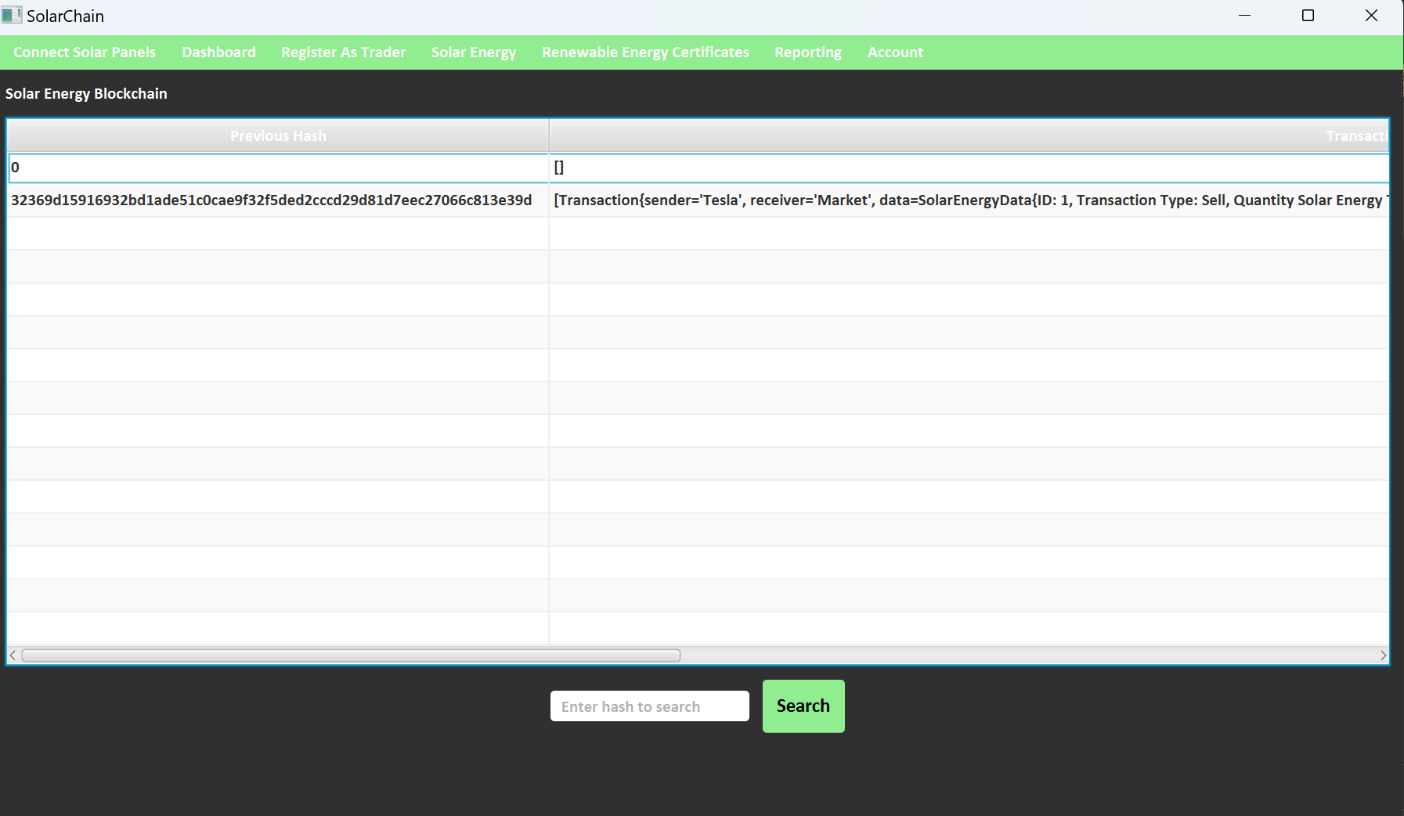

Slide 24
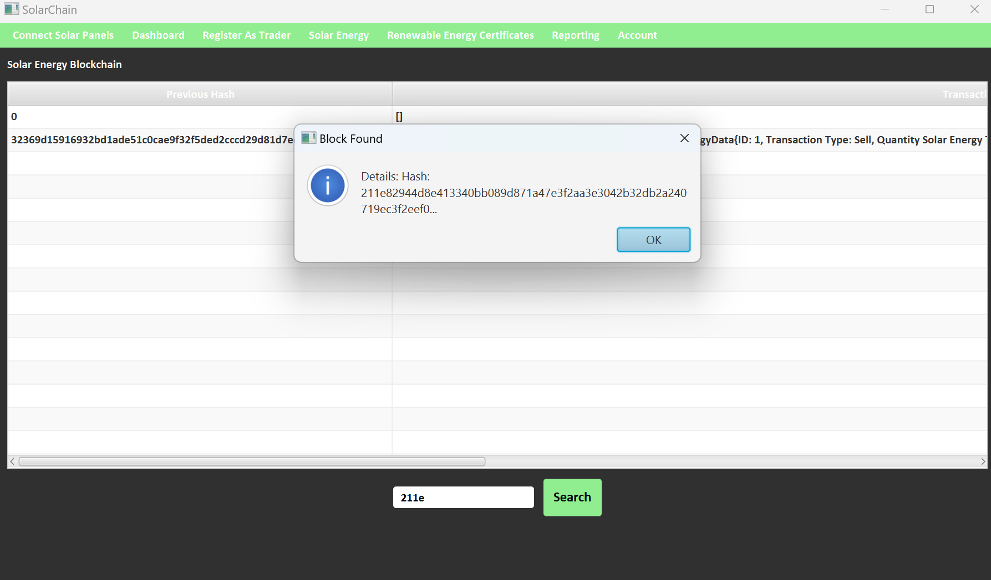

Slide 25
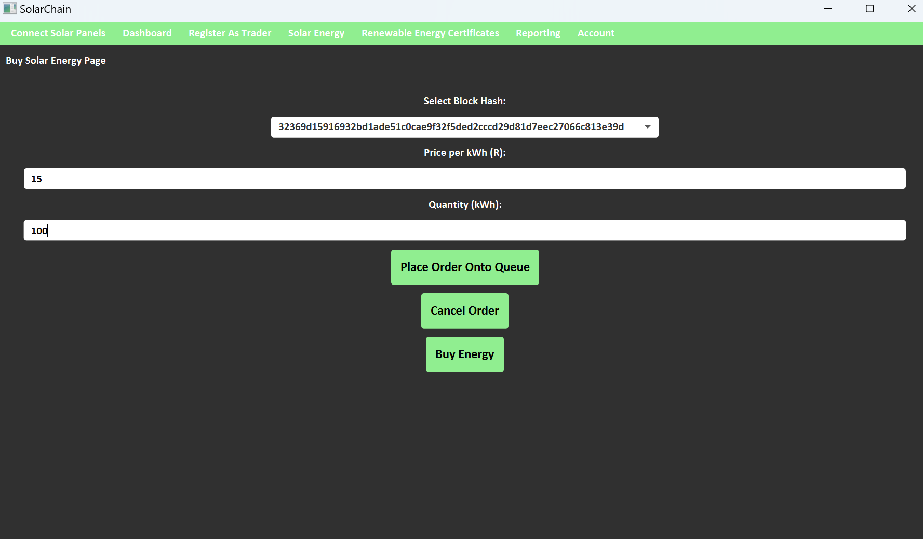

Slide 26
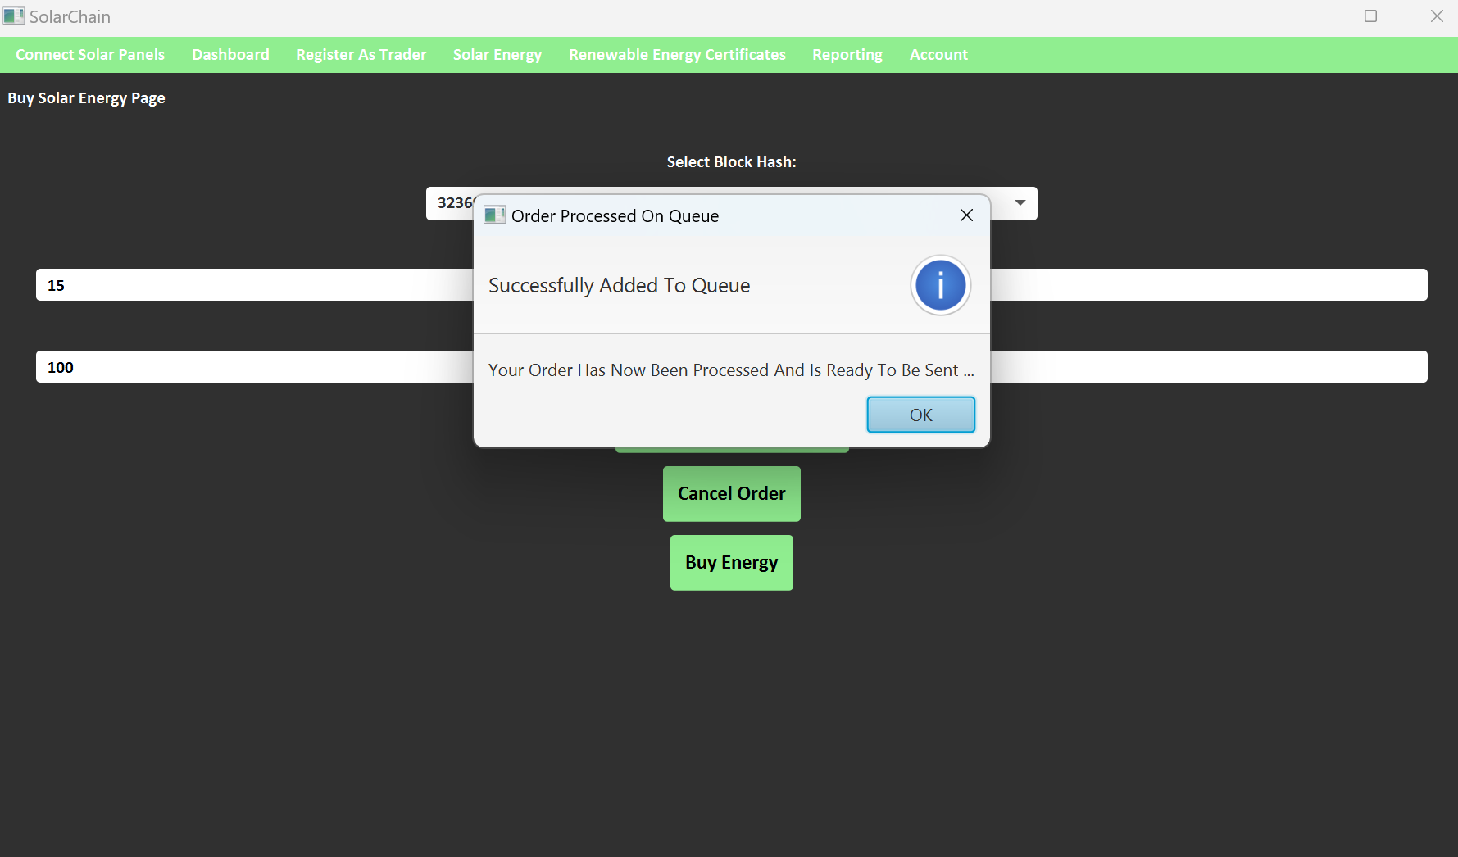

Slide 27
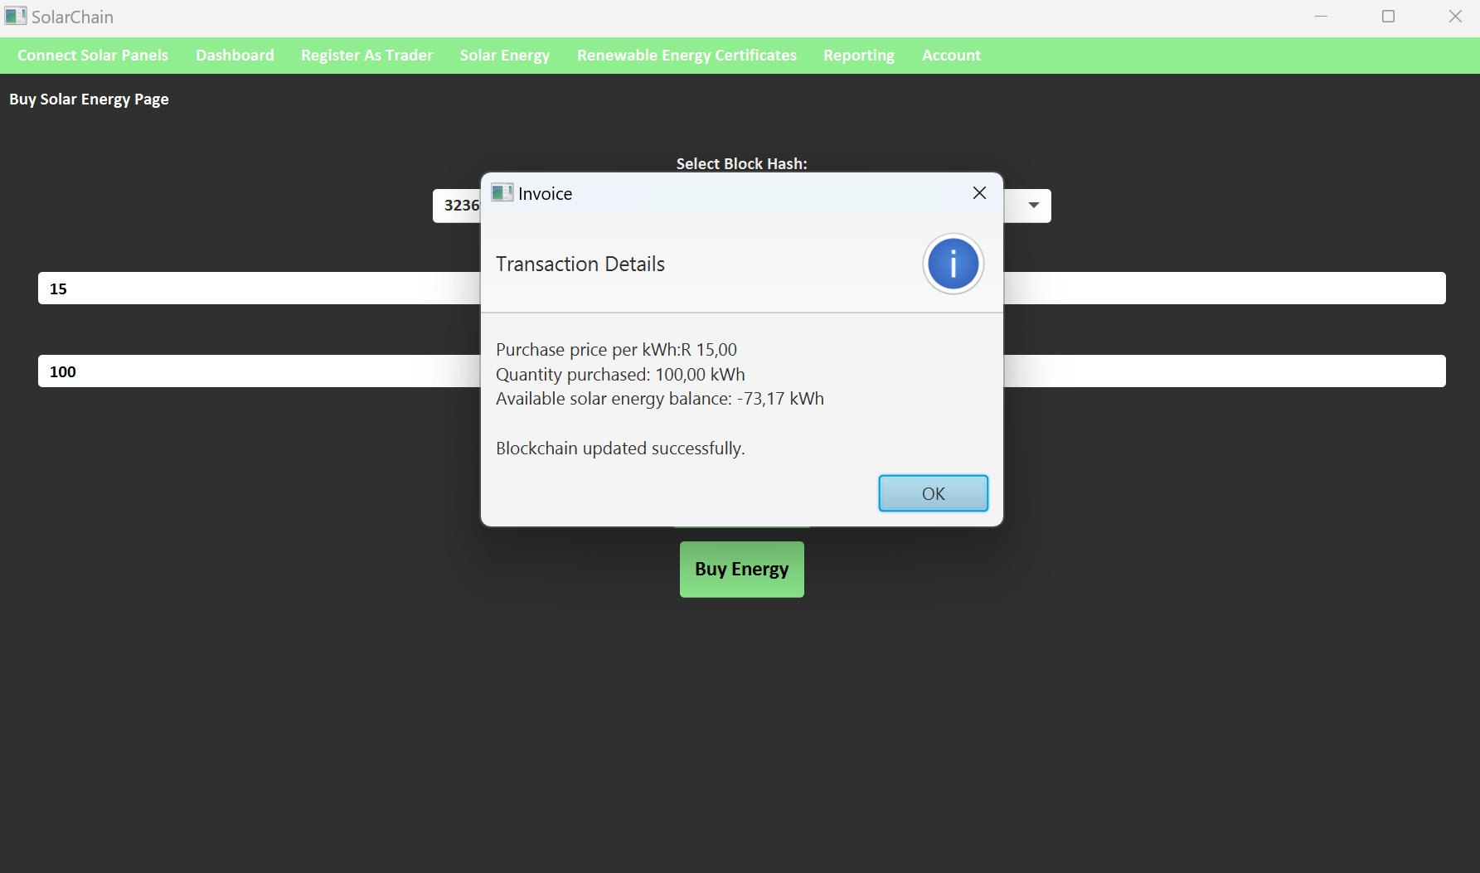

Slide 28
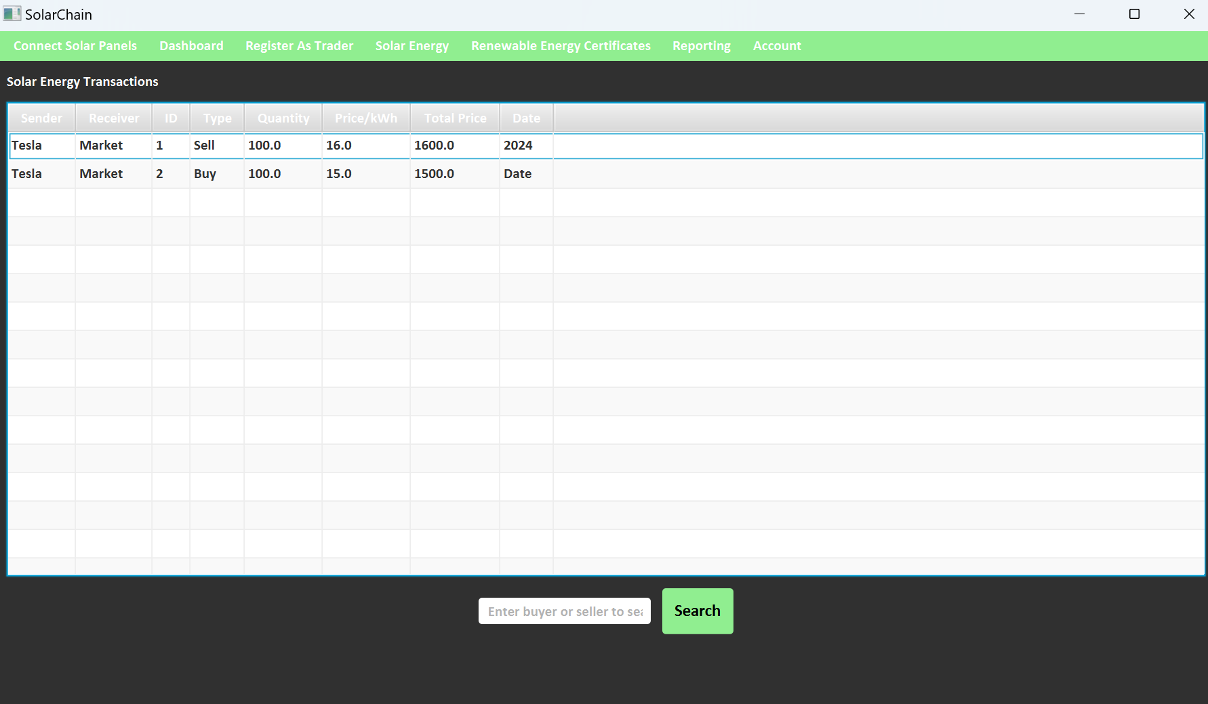

Slide 29
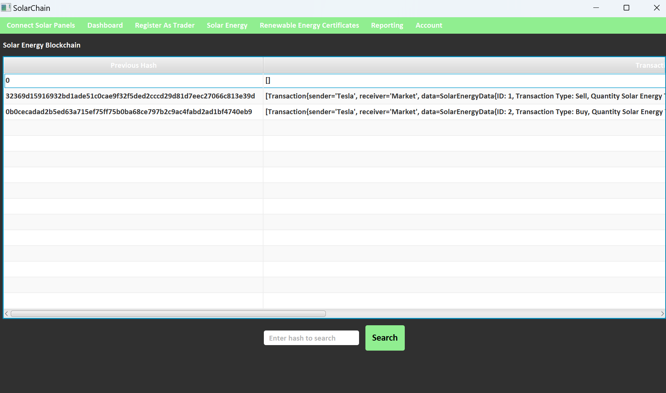

Slide 30
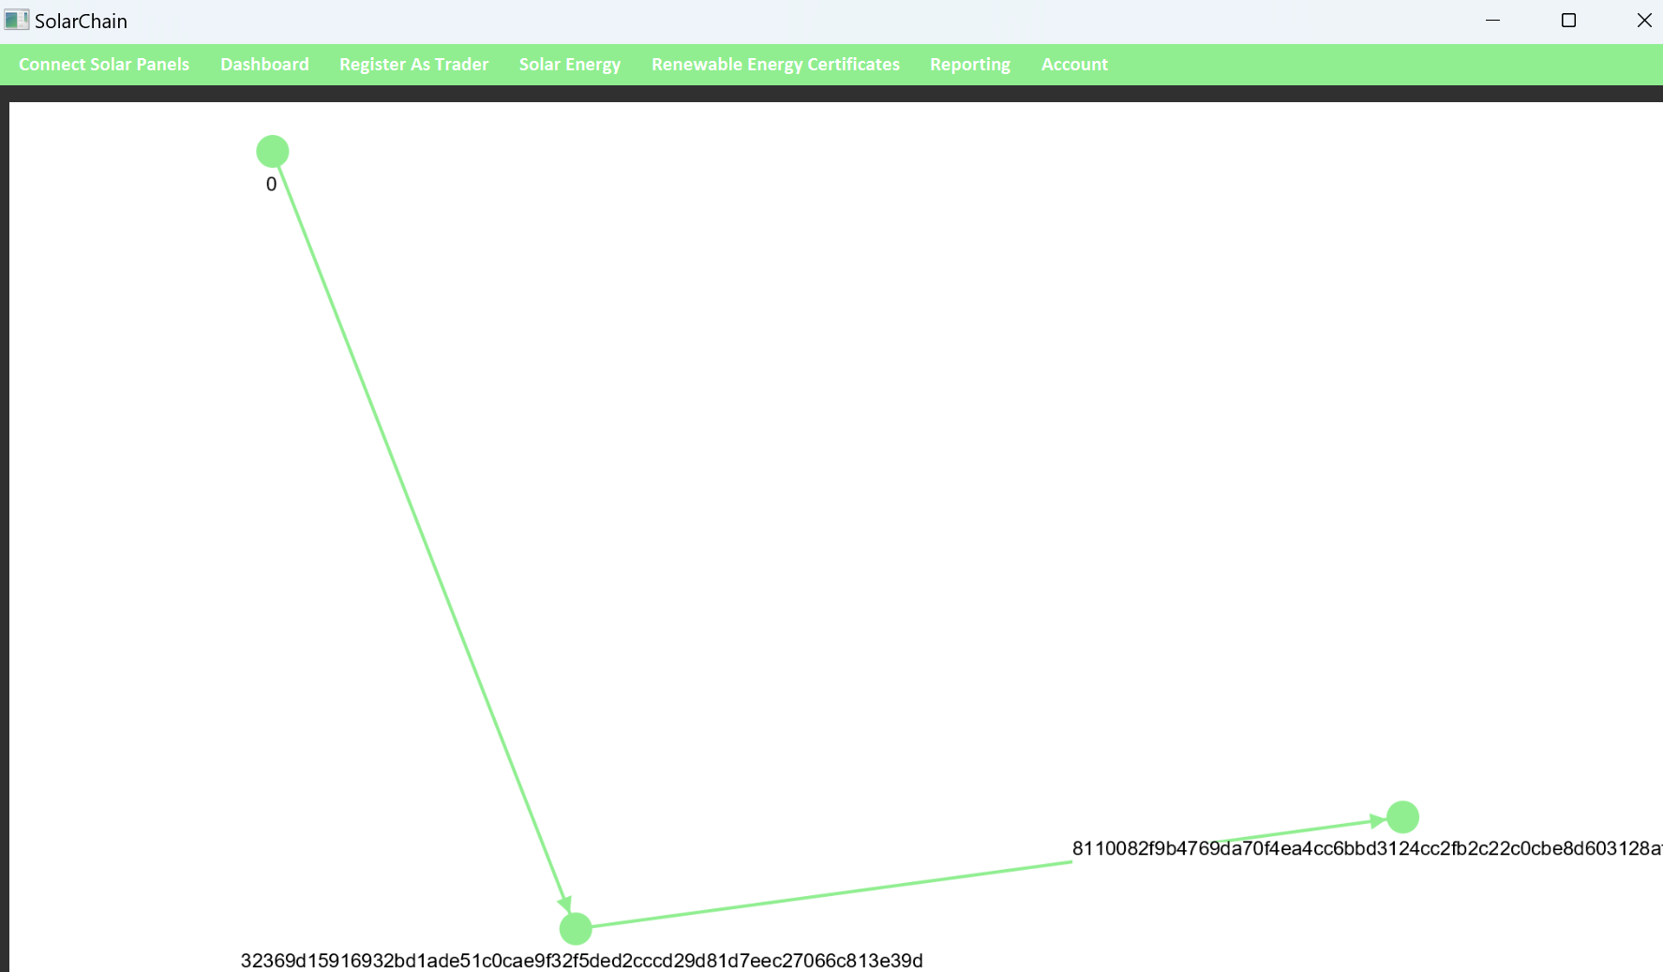

Slide 31
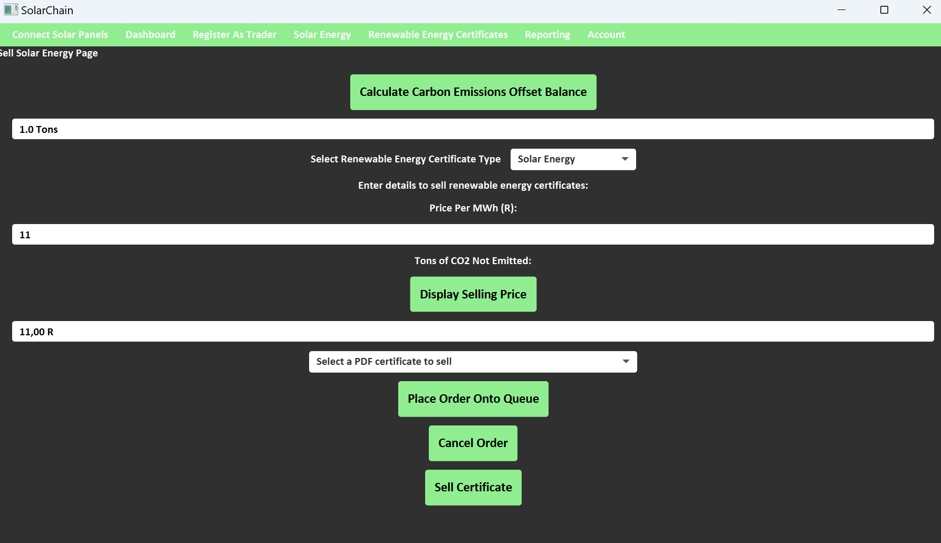

Slide 32
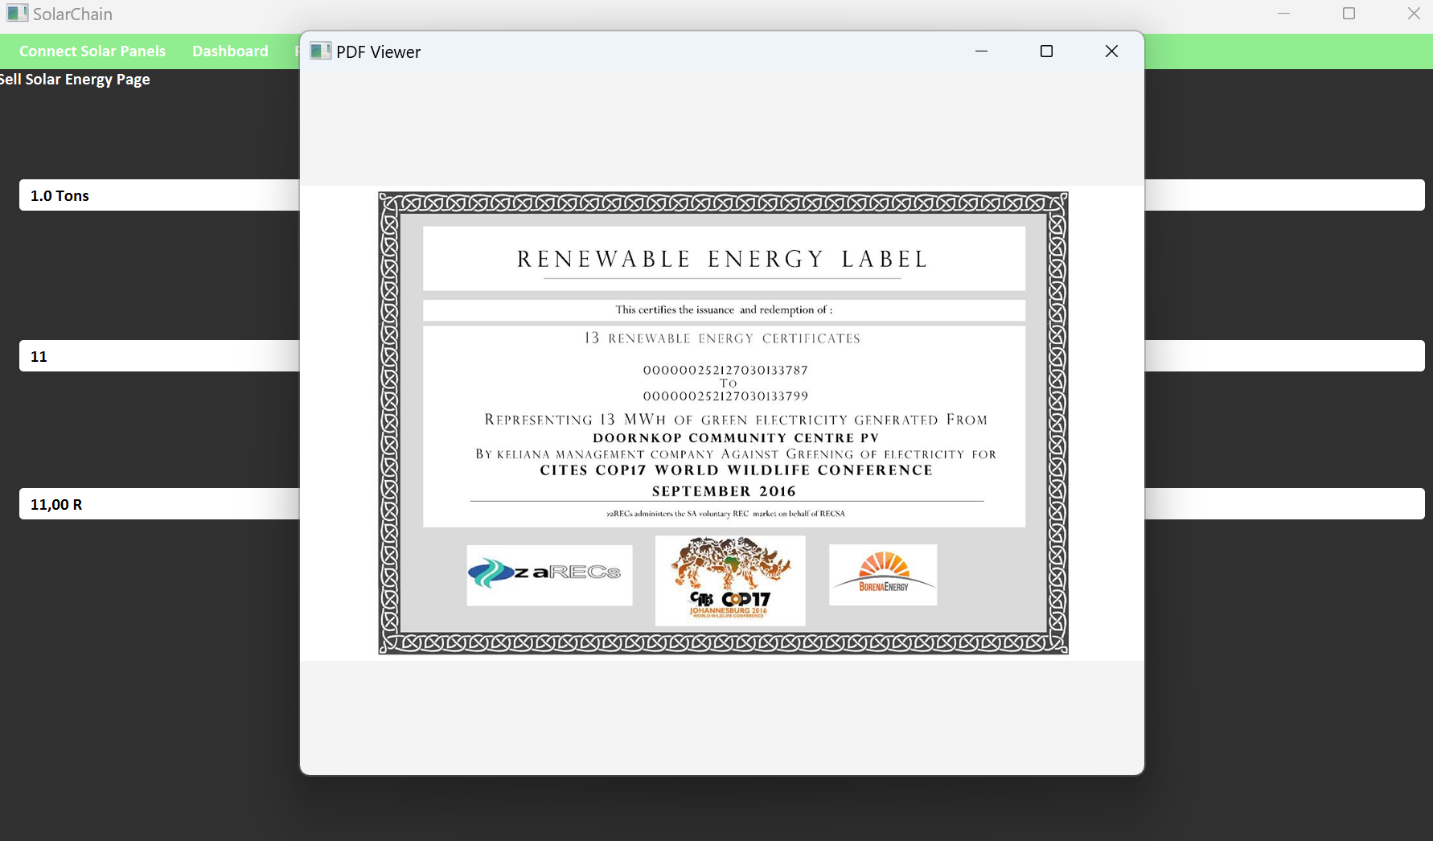

Slide 33
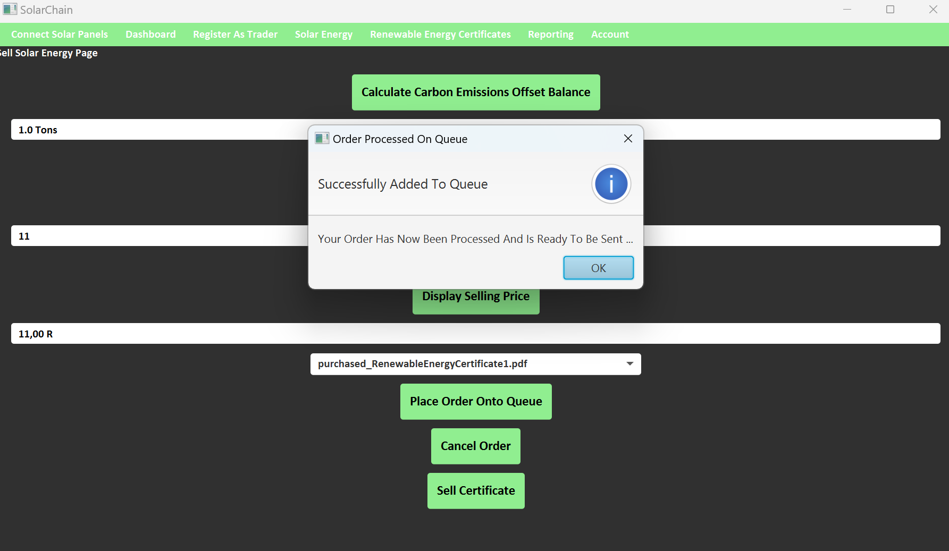

Slide 34
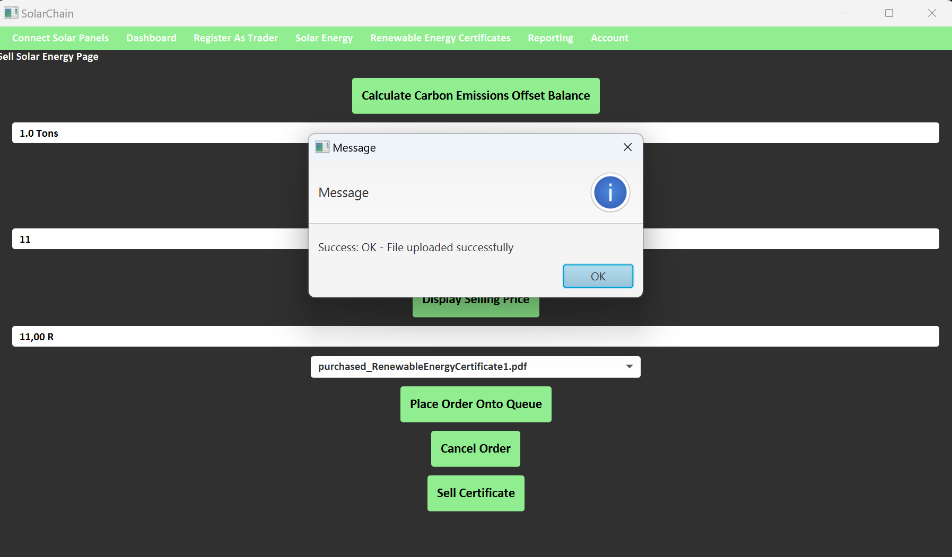

Slide 35
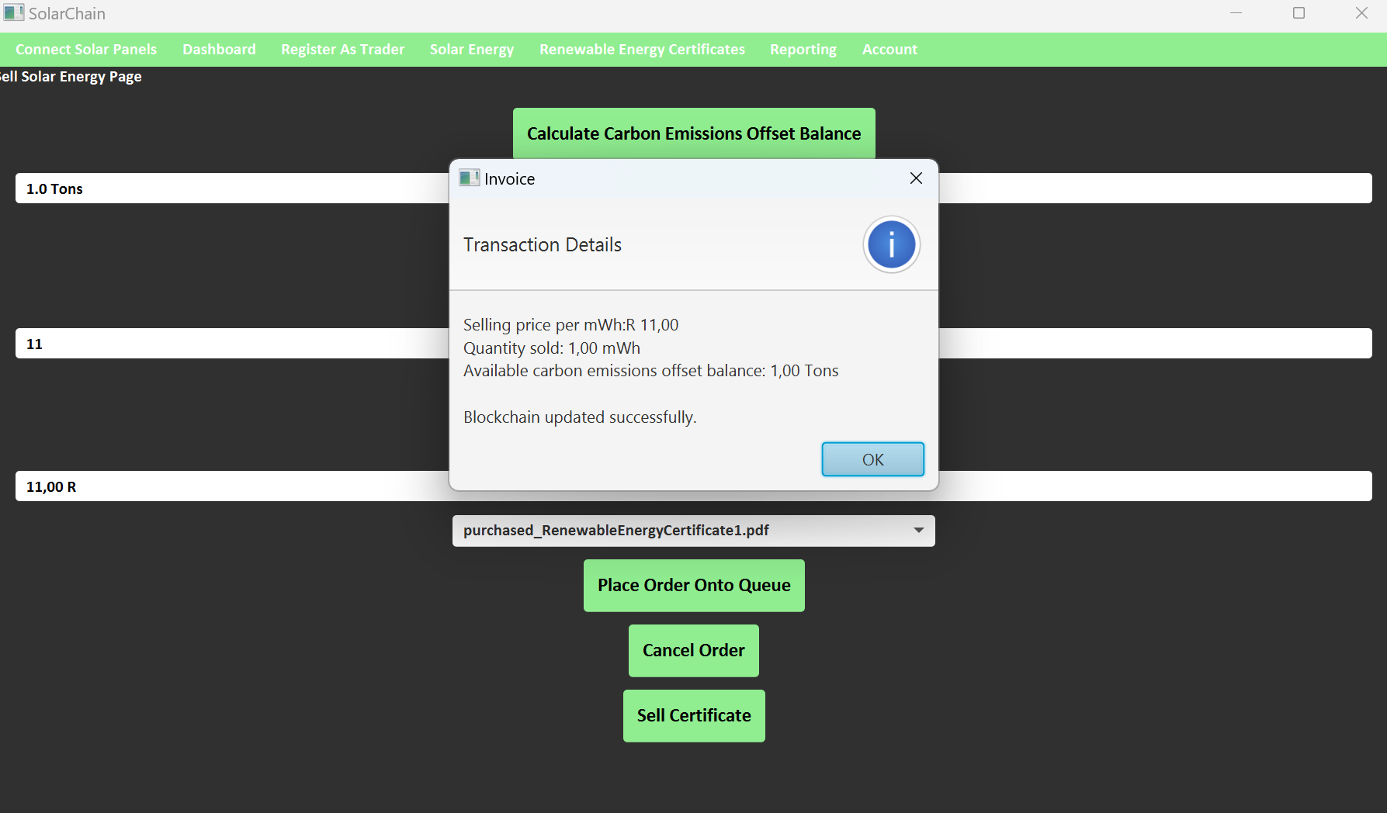

Slide 36
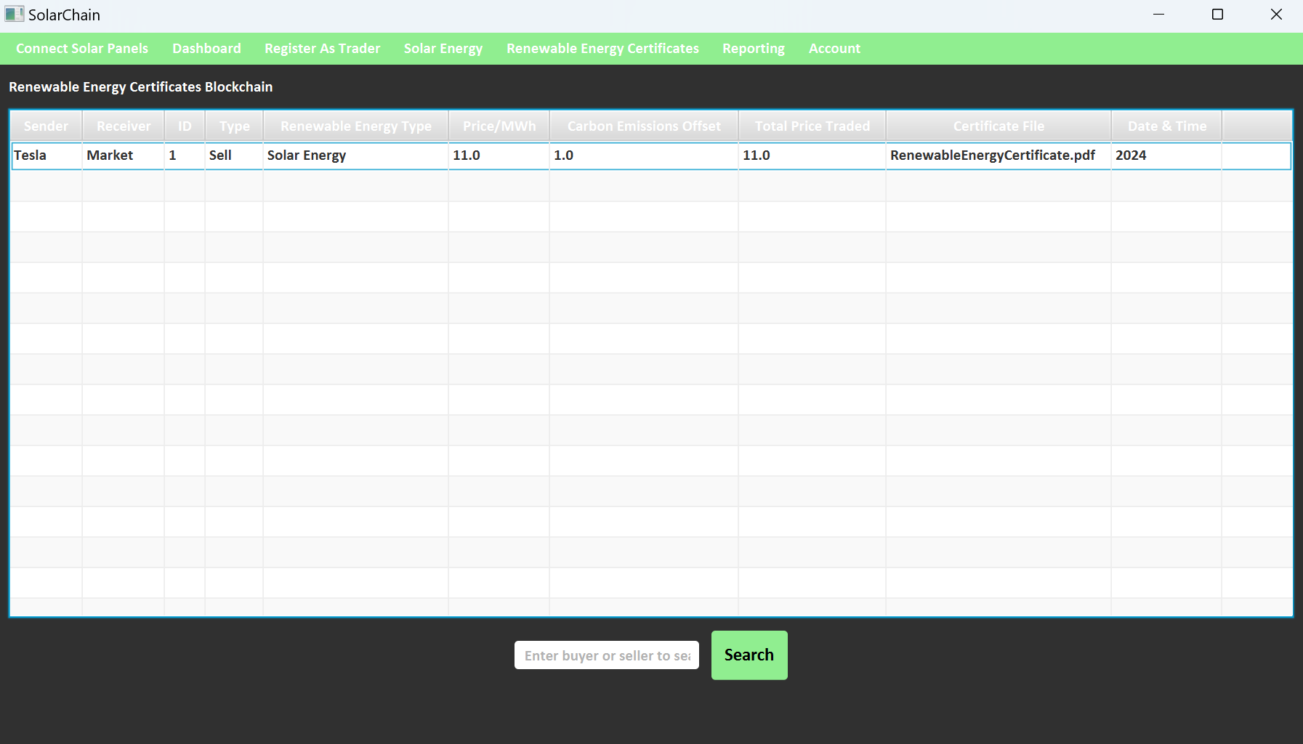

Slide 37
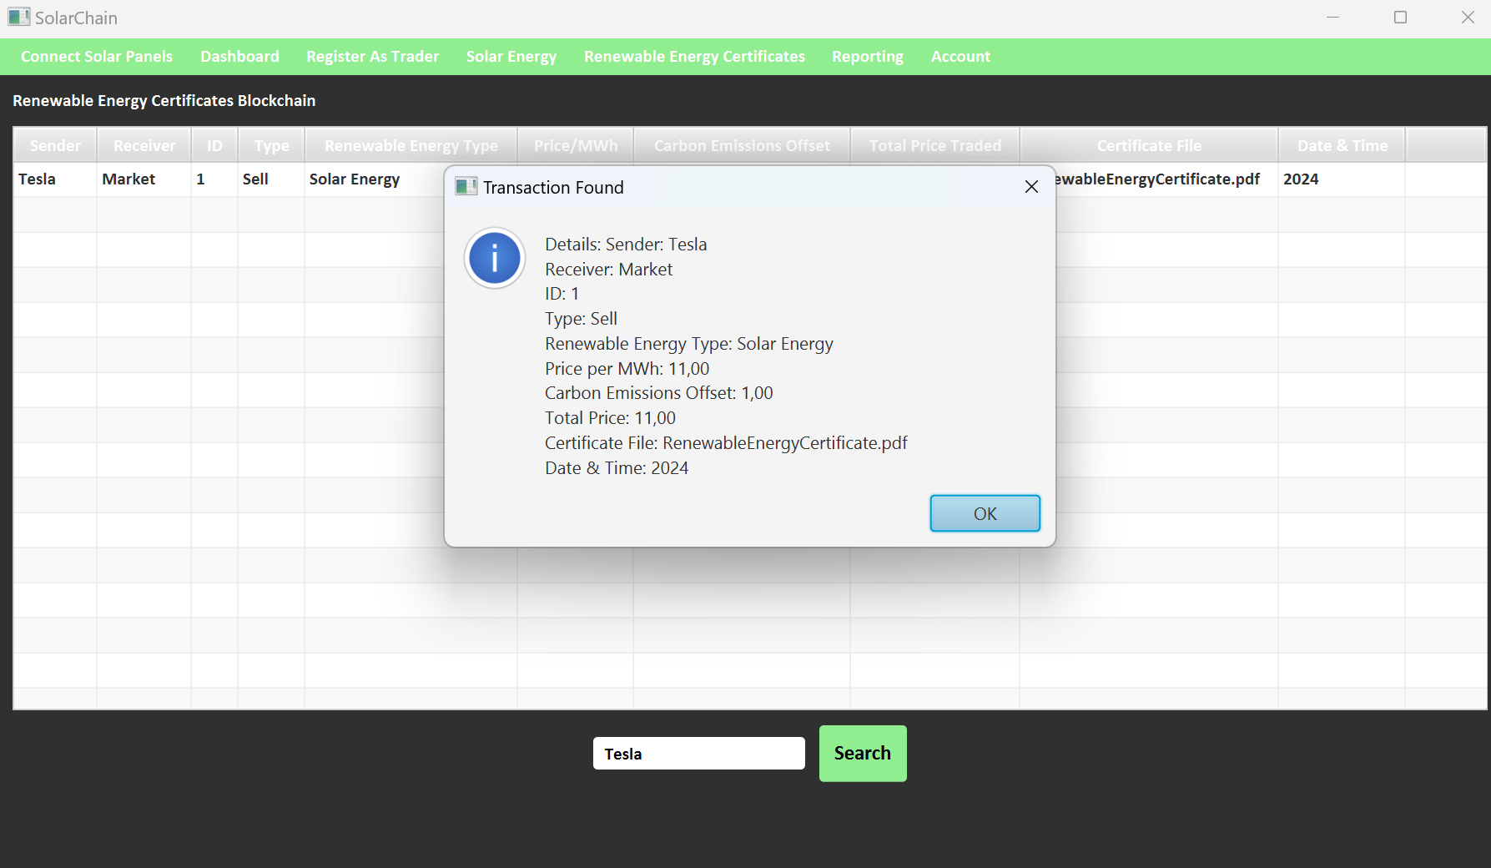

Slide 38
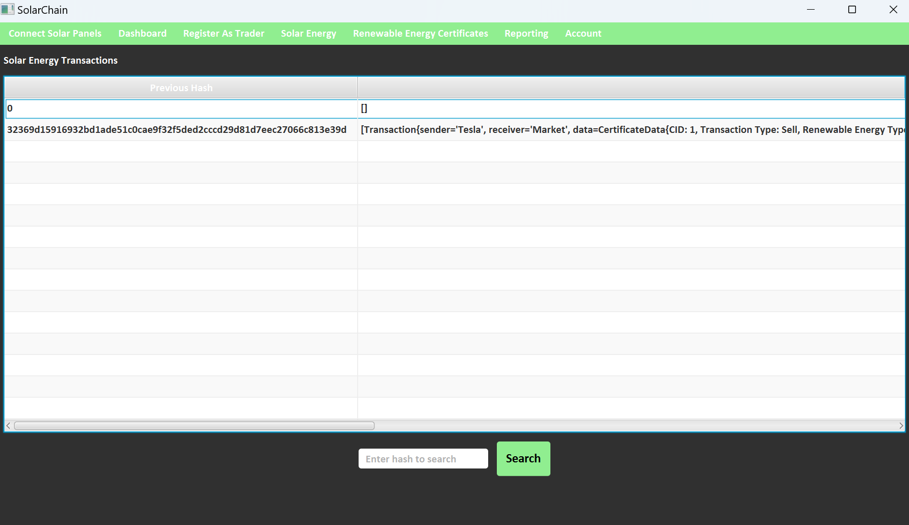

Slide 39
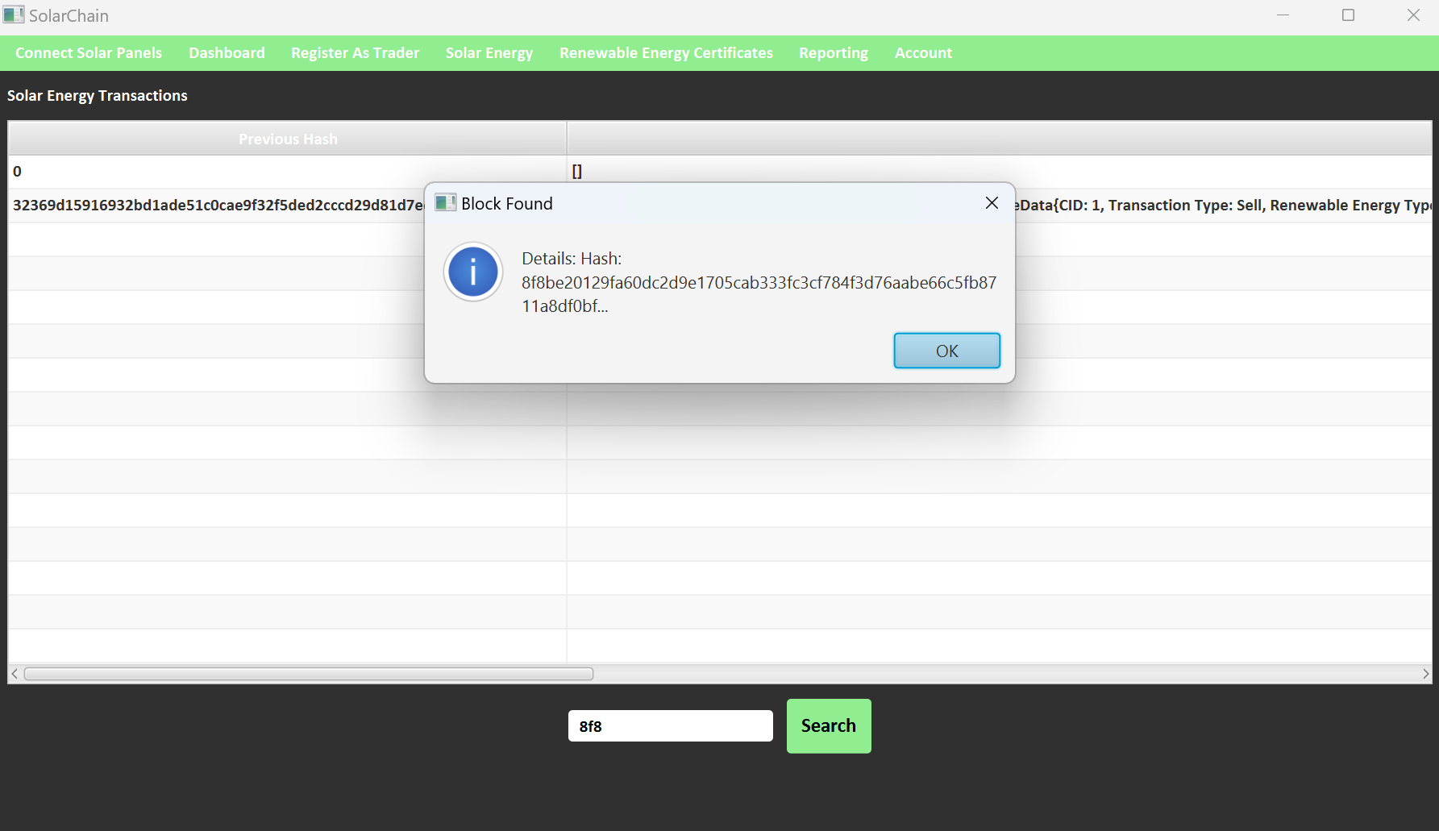

Slide 40
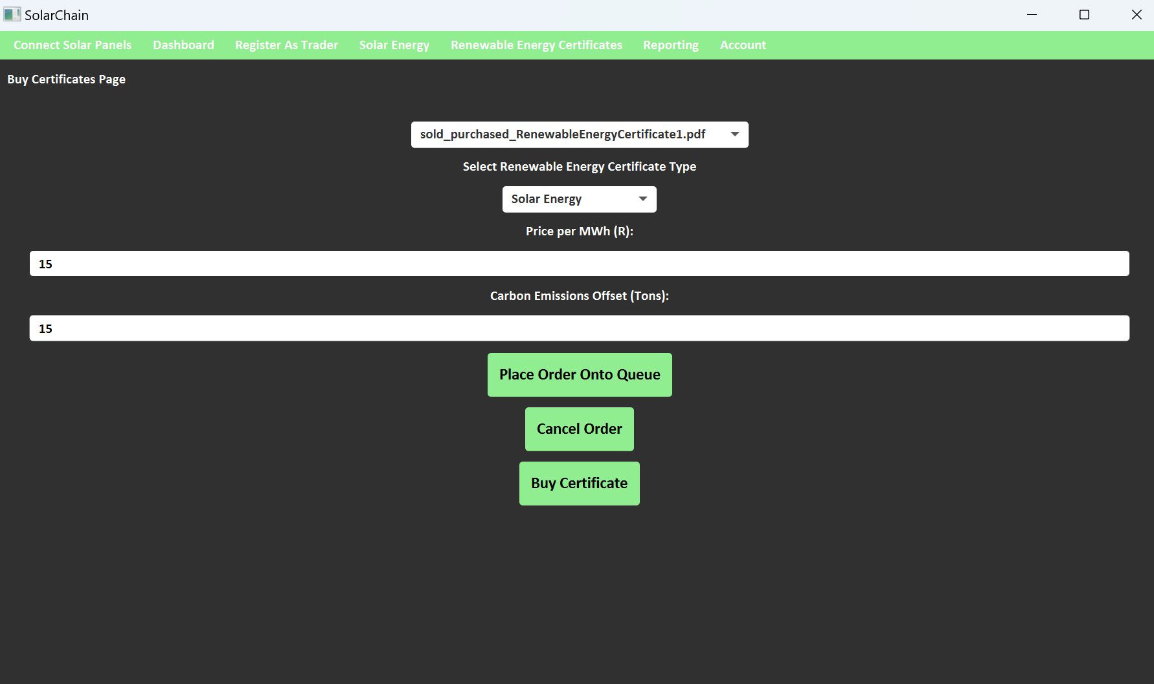

Slide 41
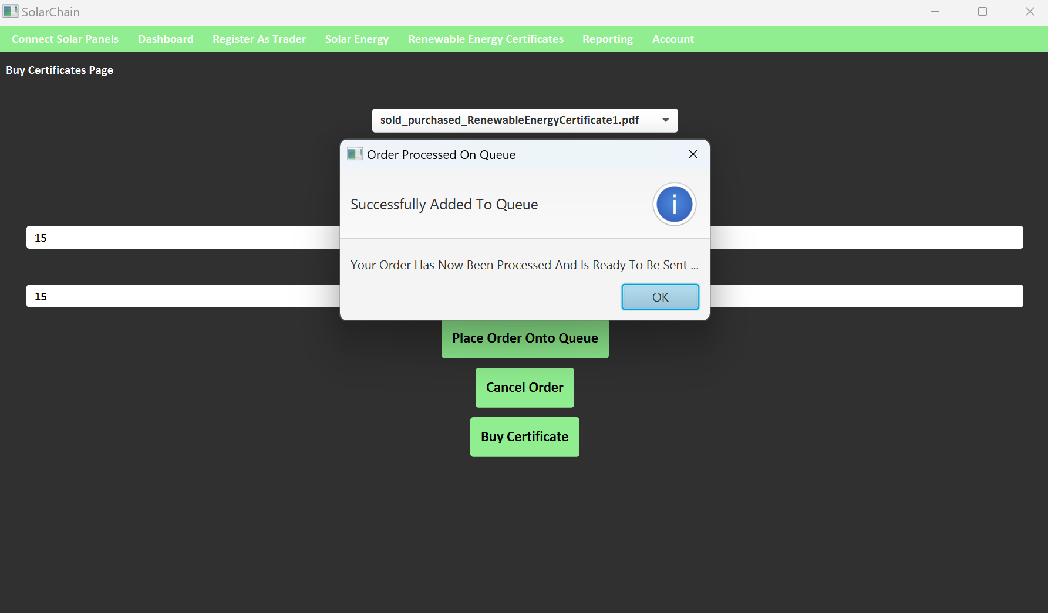

Slide 42
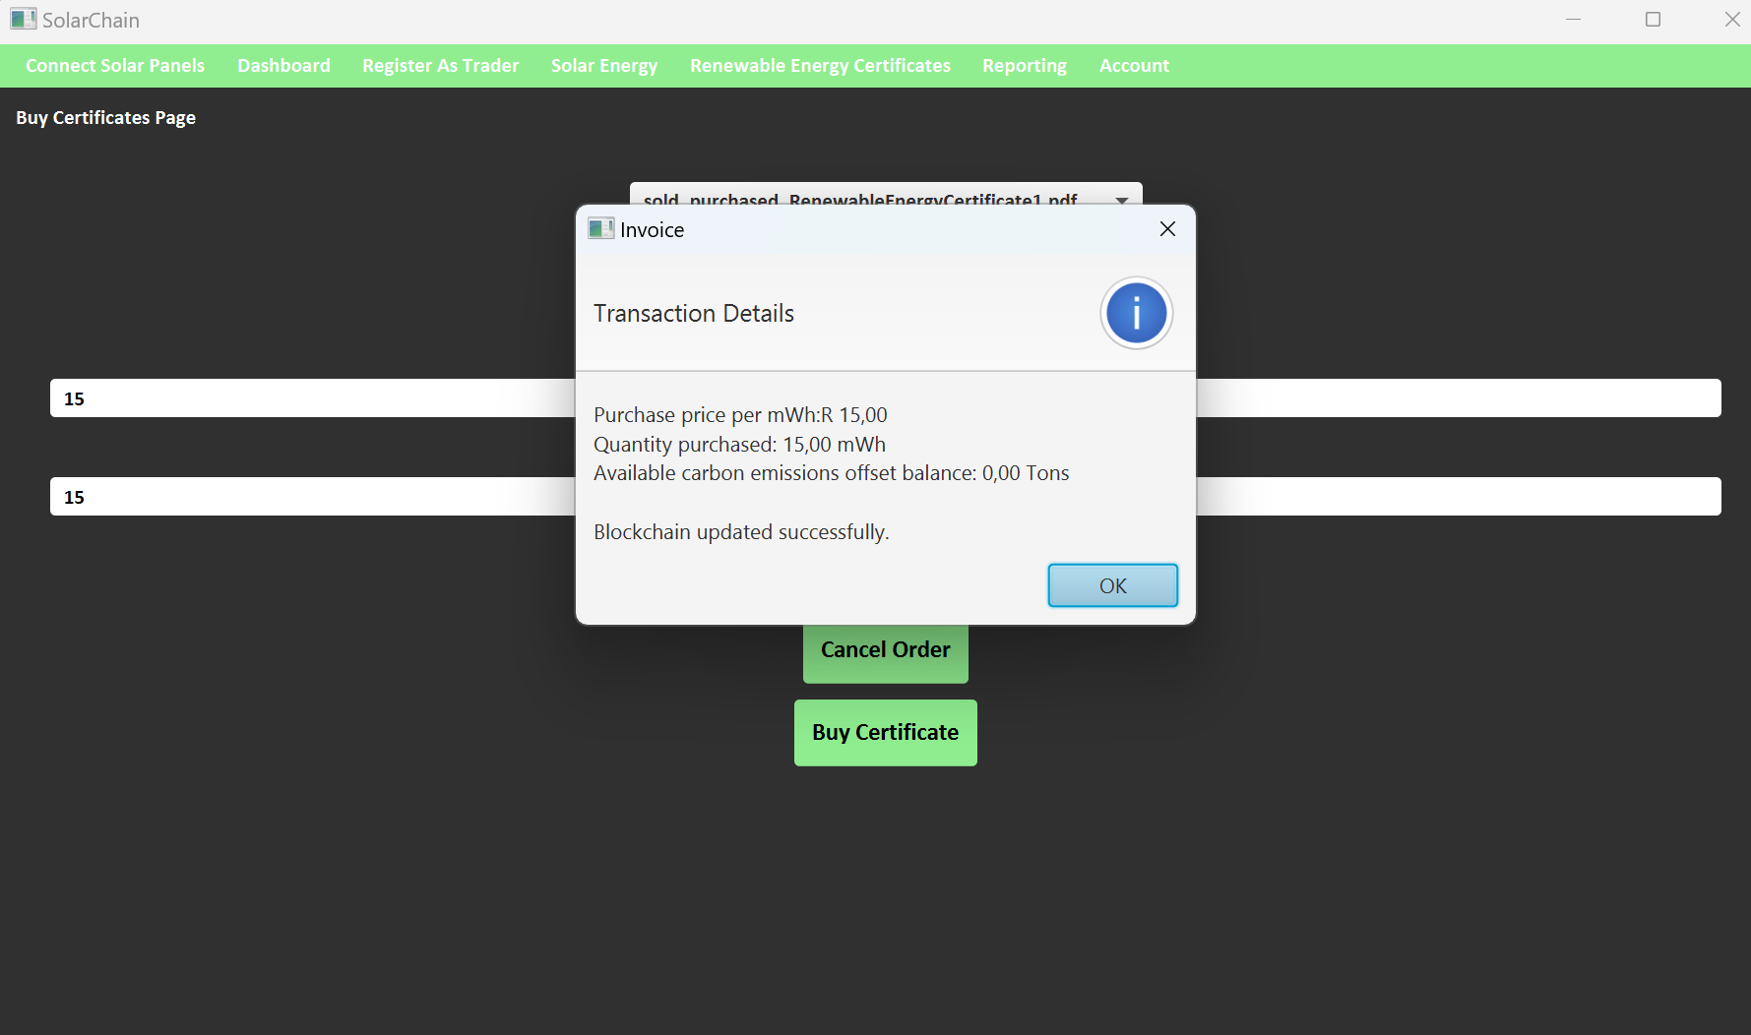

Slide 43
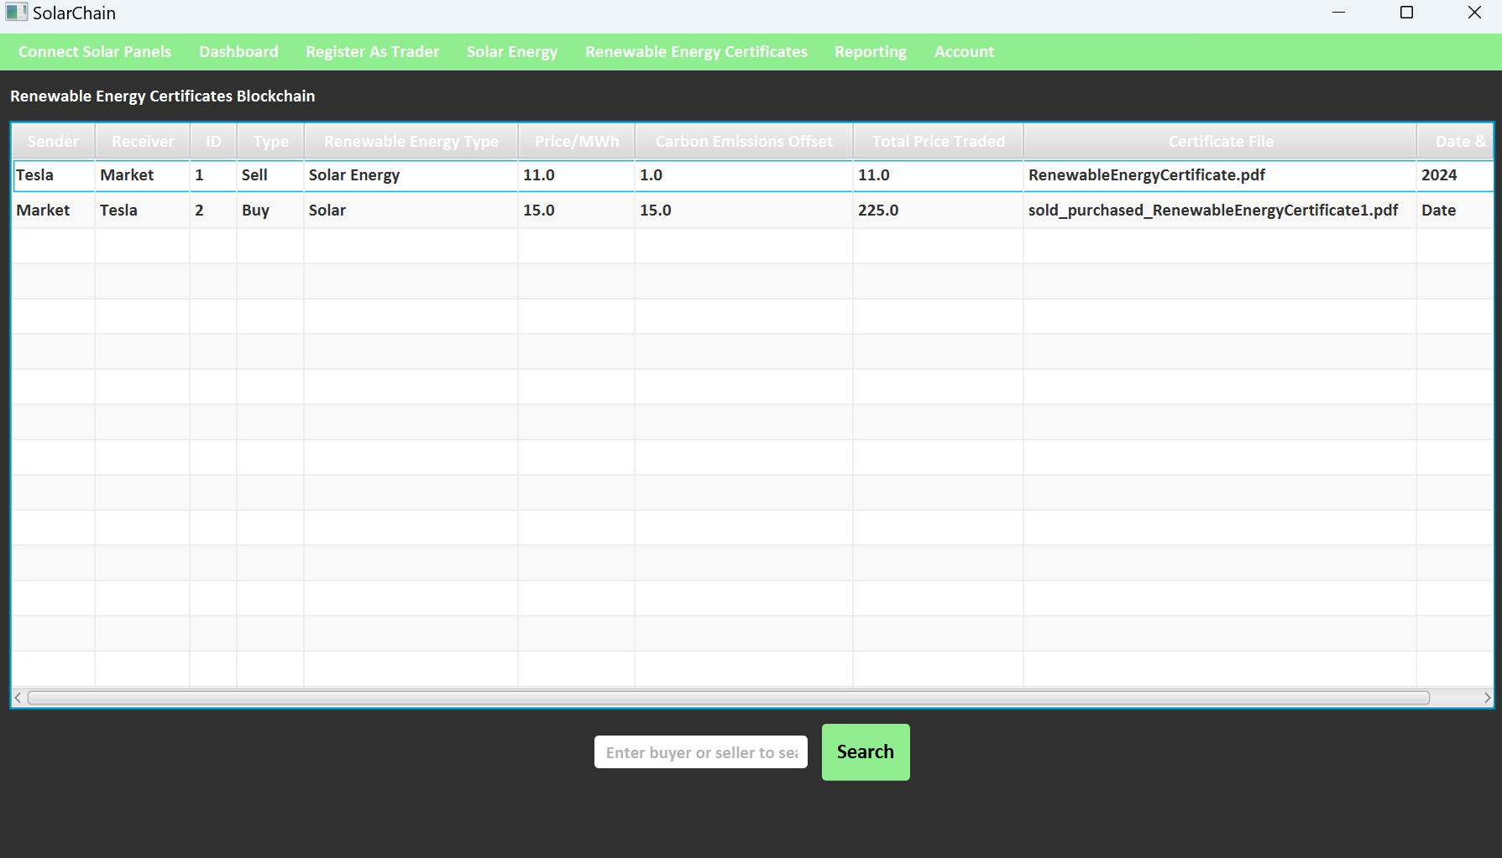

Slide 44
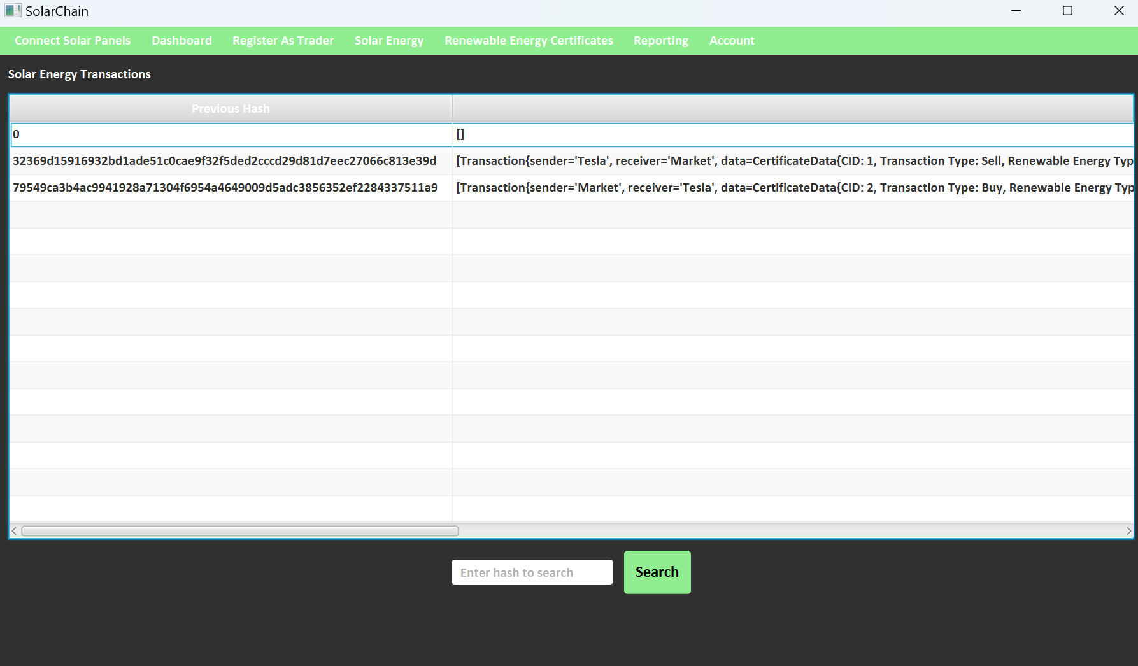

Slide 45
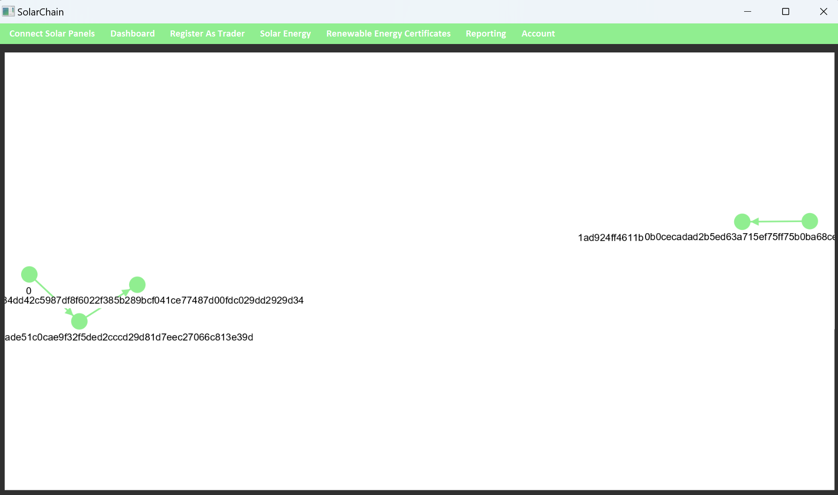

Slide 46
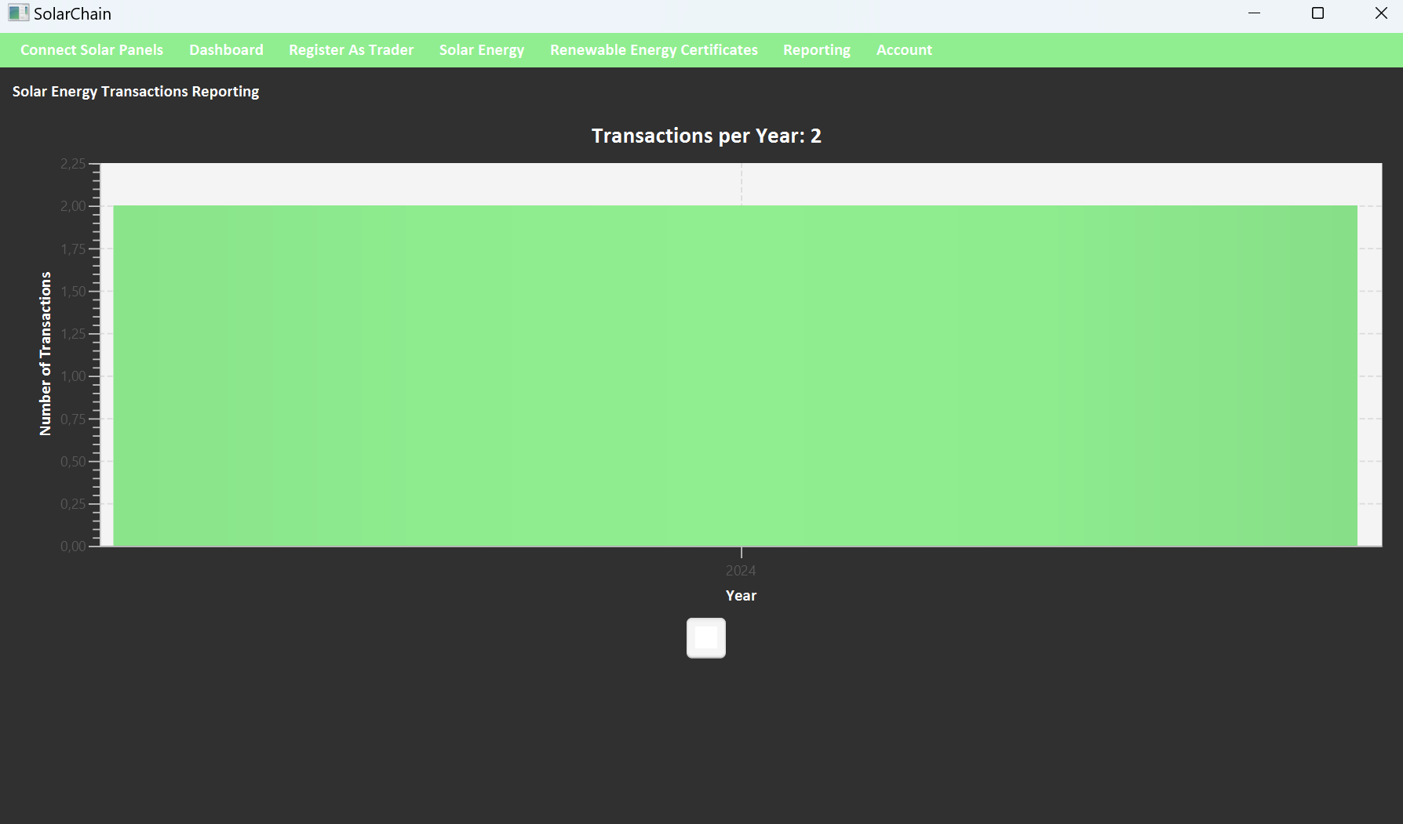

Slide 47
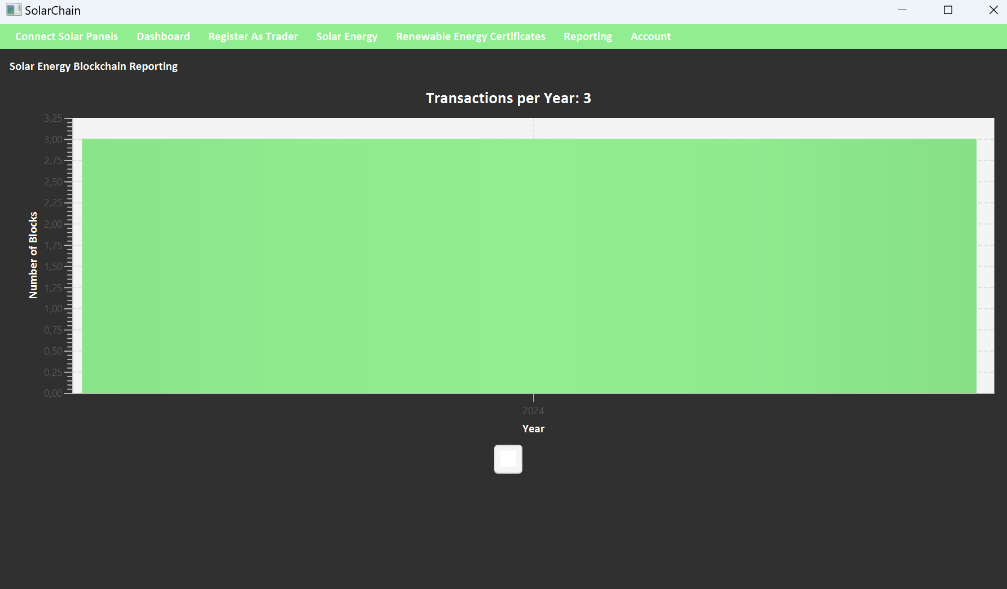

Slide 48


Slide 49


Slide 50
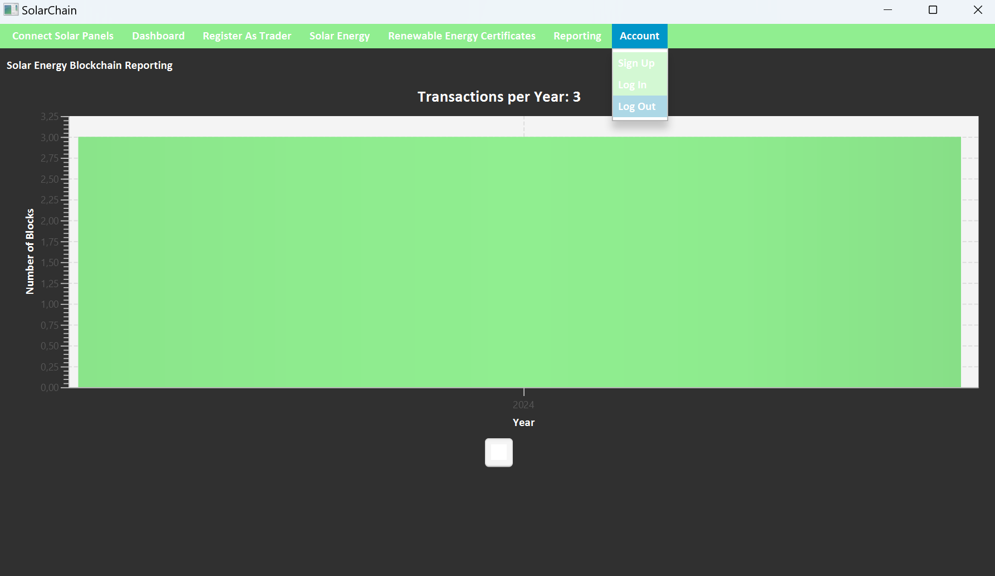

Slide 51
Thank You

